Slide 1
Bicycle-sharing
project

Slide 2
General information
Project
analysis of information related to cycle-sharing system using sql
Main source of information
database include information about stations, trips and weather
System location
seattle, usa

Slide 3
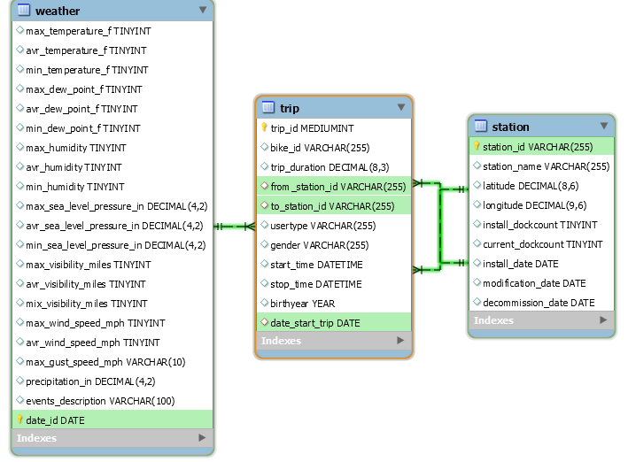
ER-model database

Slide 4
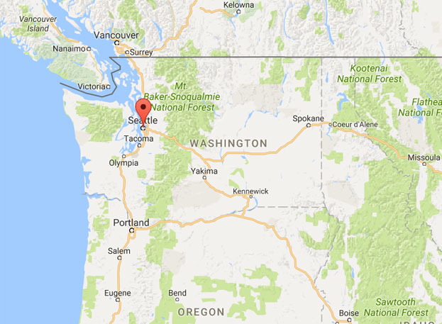
General information
Seattle
is a seaport city on the West Coast of the United States.
744 955 people
population in 2018
367.97 km²
city area

Slide 5
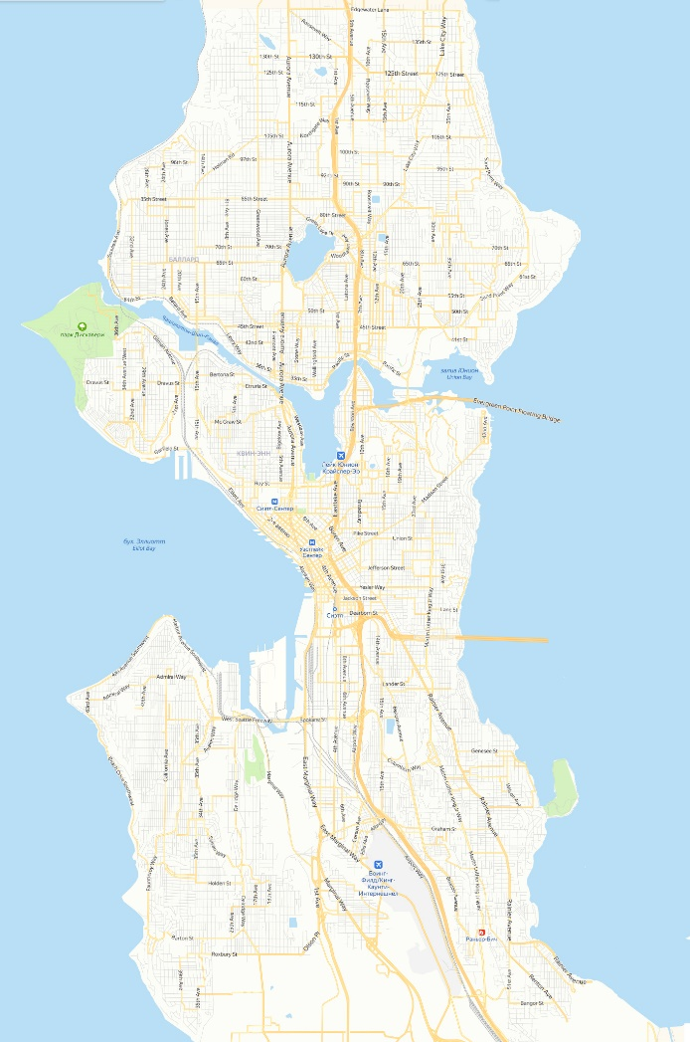
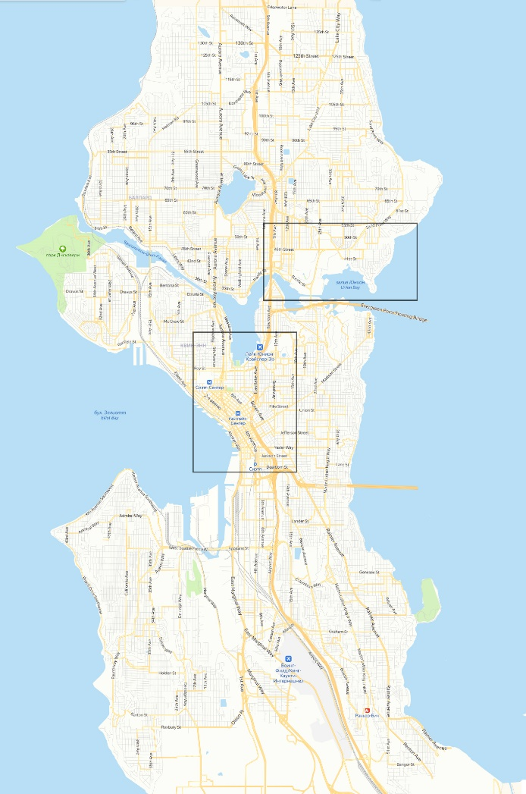
Seattle map and city area under review

Slide 6
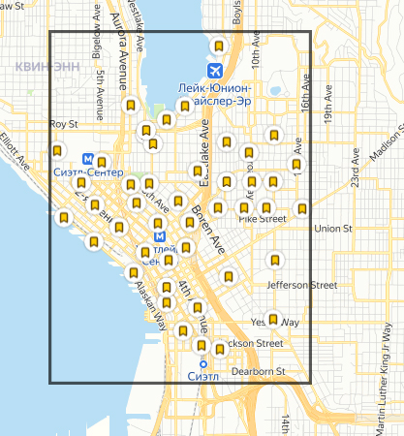
Number of cycle-sharing stations: 45

Slide 7
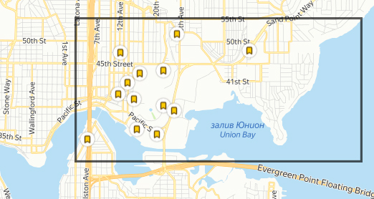
Number of cycle-sharing stations: 13

Slide 8
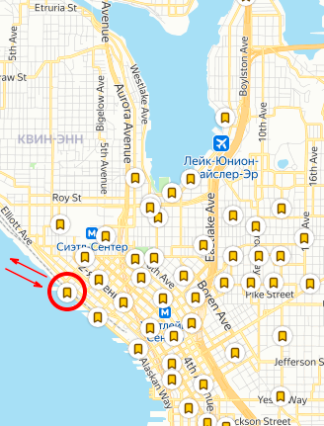
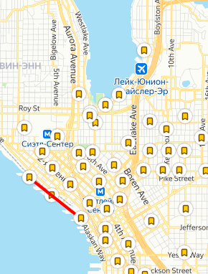
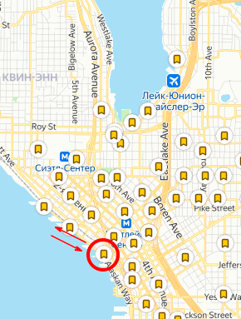
The most popular routes
4209 trips (from/to)
3896 trips (from/to)
1150 trips (from/to)

Slide 9
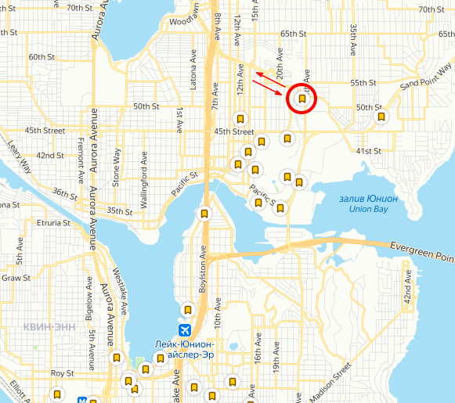
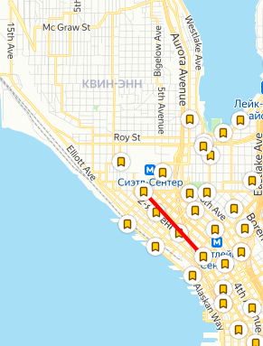
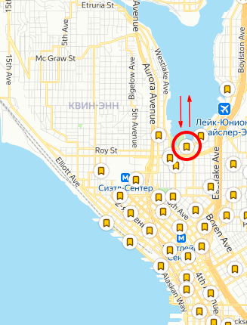
The most popular routes
2063 trips (from/to)
960 trips (from/to)
880 trips (from/to)

Slide 10
Information related to load by stations
Station | Maximum planned load in 2016 | Actual number of trips | load percentage
WF-01 | 361506 | 4057 | 1,12%
CH-07 | 811421 | 3220 | 0,40%
BT-01 | 403000 | 2954 | 0,73%
SLU-15 | 629702 | 2582 | 0,41%
CBD-13 | 510634 | 2257 | 0,44%
CH-08 | 1064787 | 2186 | 0,21%
SLU-19 | 366953 | 2181 | 0,59%
CH-02 | 750661 | 2131 | 0,28%
WF-04 | 247813 | 2085 | 0,84%
SLU-02 | 520972 | 2071 | 0,40%

Slide 11
Change in the number of
trips
bikes
stations

Slide 12
Data related to trips
28794.398 seconds
maximum trip duration
1202.6674462 seconds
average trip duration
60.008 seconds
minimum trip duration
gone in sixty seconds
2000
year of birth of the youngest client
1931
year of birth of the oldest client

Slide 13
Data related to trips
146156
of trips were made by members
89887
of trips were made by short-term pass holder
1
trip were made by the Creator
112928
number of trips with men
30327
number of trips with women
2901
number of trips with others
89888
number of trips with sexless

Slide 14
Number of trips in different age groups

Slide 15
Data related to trips
number of trips depending on the time of day
number of trips depending on the season

Slide 16
Weather

Slide 17
Number of trips in certain weather

Slide 18

Conclusion

Slide 19

Thanks for your attention. Hell is over.

